Slide 1
Mogollon Civilization
Culture that existed in the South West from 200-1450 A.D.

Slide 2
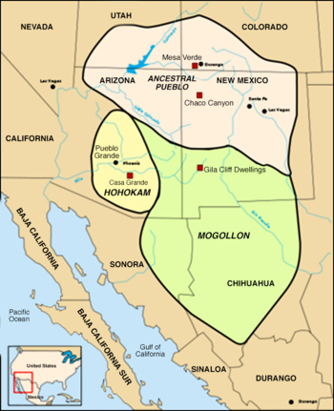
G- Geography
Mogollon lived in South East Arizona and South West New Mexico

Slide 3
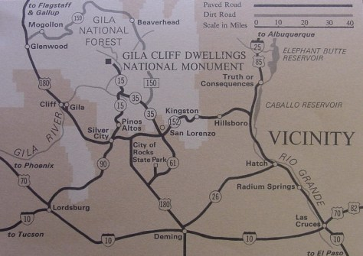
Lived in the Mogollon Mountains

Slide 4
R-Religion-What were their beliefs?
Believed in more than one god so polytheistic
Had kivas that were traditionally round shape as well as D shape and large clan kivas
Had ceremonies and rituals
Buried their dead with burial pottery-bowls with animals shapes and a whole in them
Had medicine men or shaman or priests

Slide 5
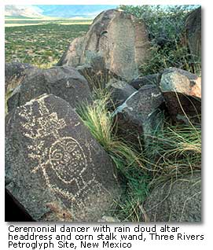

Slide 6
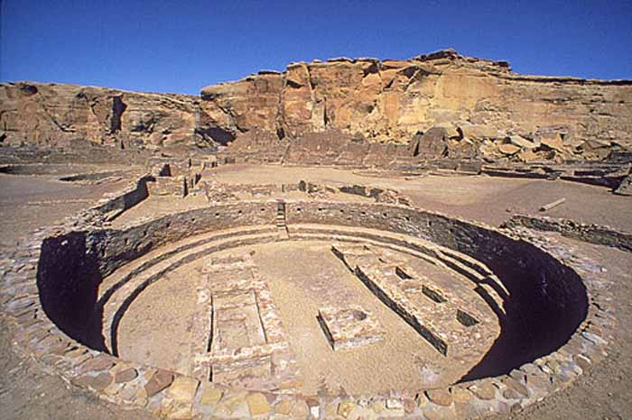

Slide 7
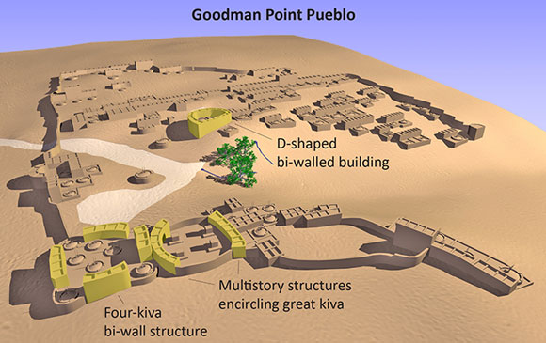

Slide 8
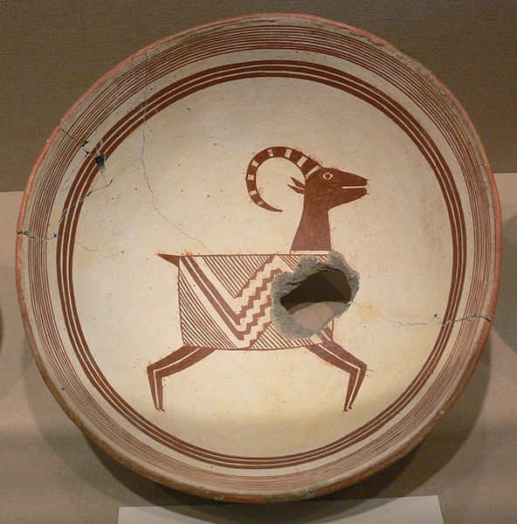
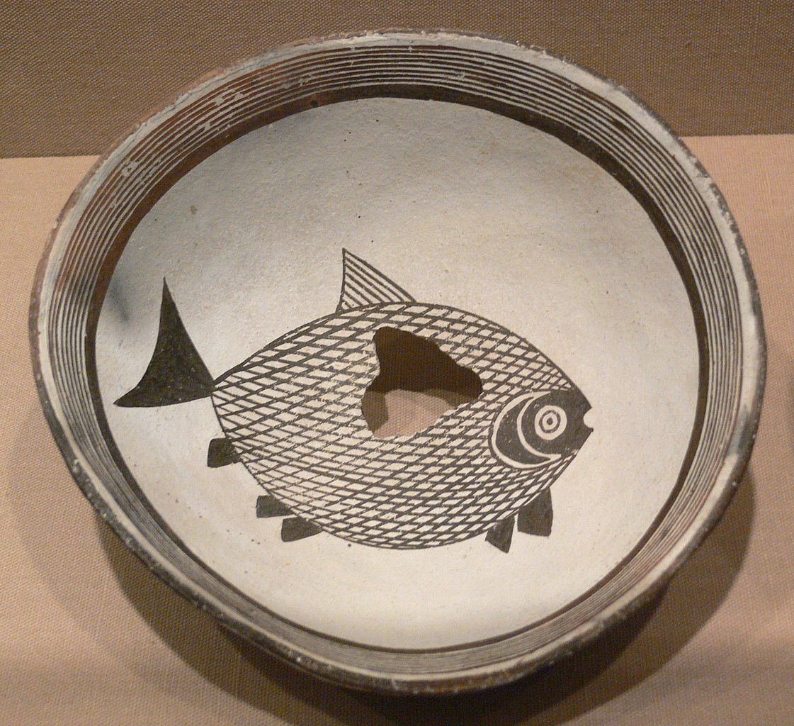
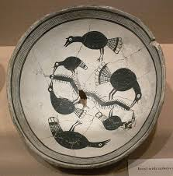

Slide 9
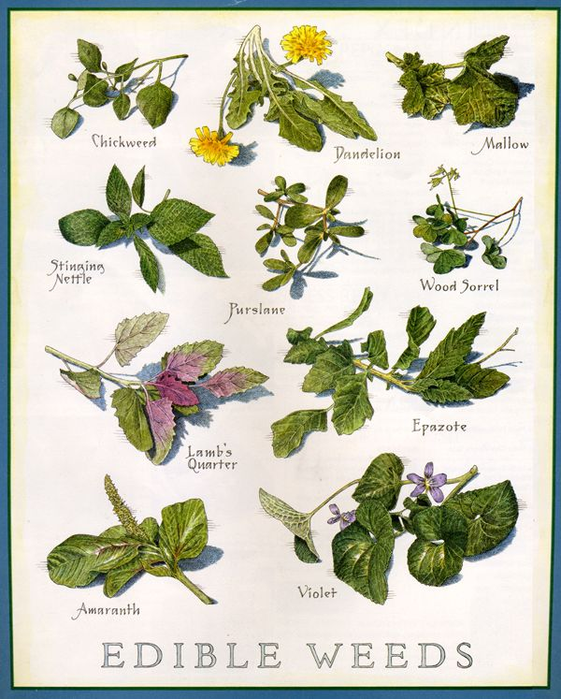
A-Achievements-What were their accomplishments?
Collected and used plants for medicine

Slide 10
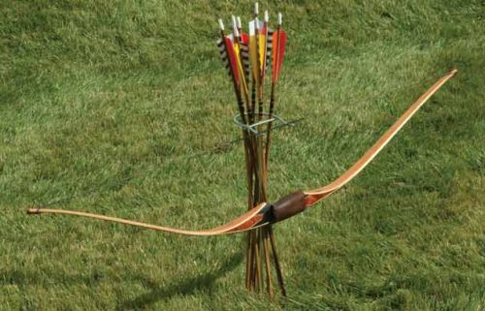
First use or inventor of the bow and arrow

Slide 11
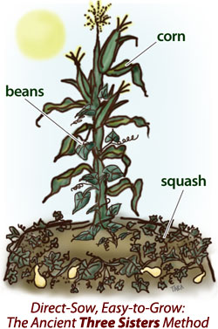
First Full time farmers in NM

Slide 12
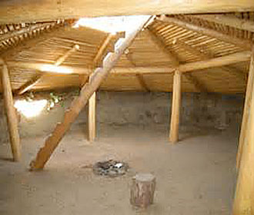
Lived in Pit Houses at first

Slide 13
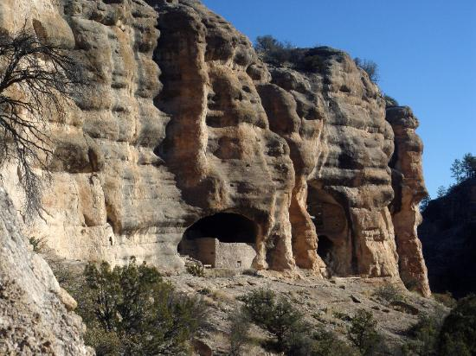
Then begin to live in the cliffs and building multi storied pueblos like the Anasazi

Slide 14
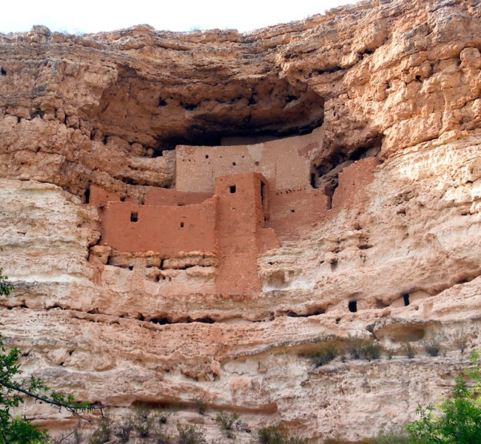

Slide 15
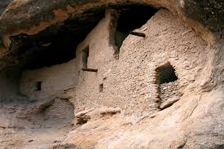

Slide 16
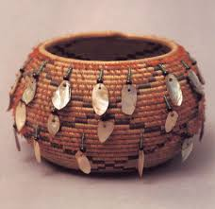
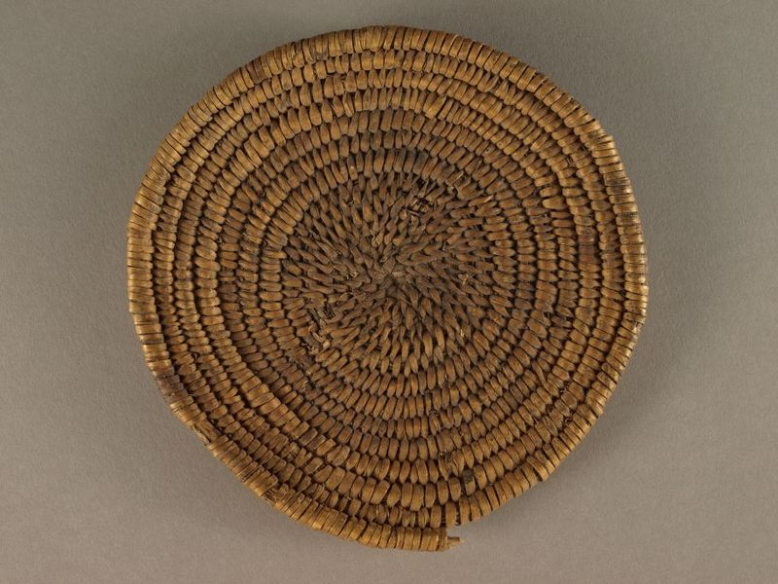
Made basketry

Slide 17
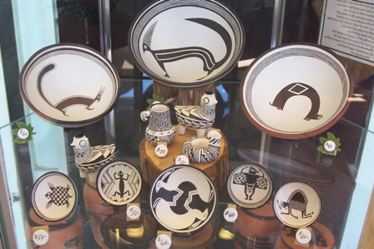
Mogollon Pottery

Slide 18
P- Politics- What was their government like?
Priest/shaman was the head of the tribe
Also had headsmen of each clan that the clan voted for
Had meetings ran by priest but the headsmen made the decisions with majority rules

Slide 19
E-Economics- How did the Mogollon make a living or survive?
For the most part they farmed corn, squash, and beans
Hunted small and big game
Fished
Trapped beavers
Traded with other tribes

Slide 20
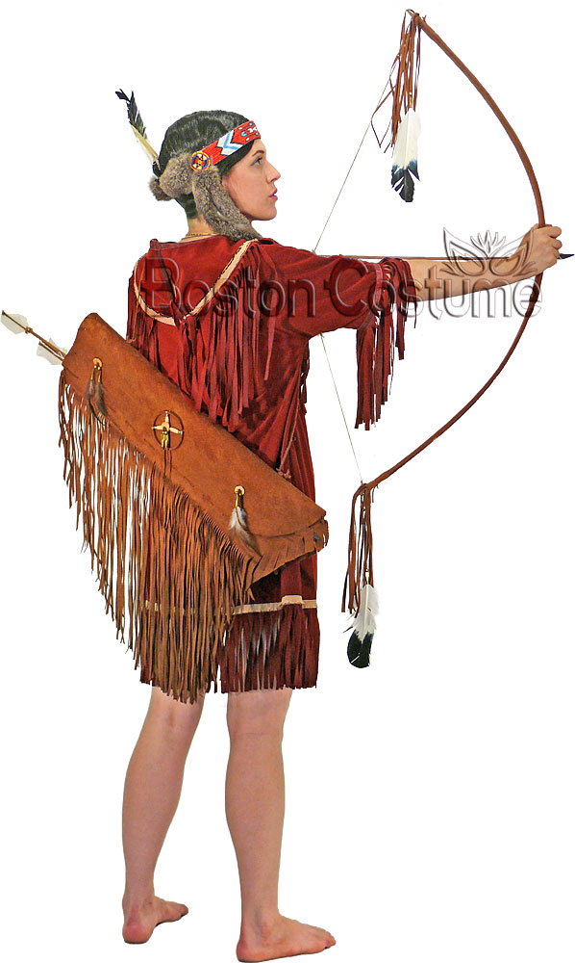
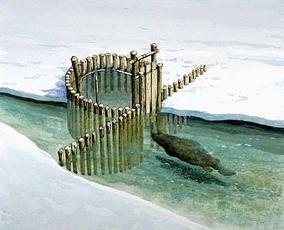

Slide 22
S- Social Structure-what were the arrangements of the people in society?
For the most part there were no social classes
There were separate women and men’s work
Women- tended the children, cooked, cleaned, made crafts and clothes
Men- farmed, hunted fished, trapped, watered crops

Slide 23
